Slide 1
Subject Name :Mobile Computing Presentation Title: Wireless Communication
JEPPIAAR INSTITUTE OF TECHNOLOGY
“Self-Belief | Self Discipline | Self Respect”
Department of Computer Science and Engineering
Team Members:
Students Name Reg.No:
1. GOPIRAJAN 210617104017
2. MOHANRAJ 210617104032
3. DHANANCHEZIAN 210617104014
4. RAJKUMAR 210617104044
5. ADITHYA PRABHAKARAN 210617104003
6. CHANDRASURIYA 210617104013

Slide 2
Objective
To Design/ Analyze/ Evaluate
It is one of the most important mediums of transmission of information from one device to other devices.
In this technology, the information can be transmitted through the air without requiring any cable or wires or other electronic conductors, by using electromagnetic waves like IR, RF, satellite, etc
In the present days, wireless communication system has become an essential part of various types of wireless communication devices, that permits user to communicate even from remote operated areas.
There are many devices used for wireless communication like mobiles
Cordless telephones, Zigbee wirelss technology, GPS, Wi-Fi, satellite television and wireless computer parts.
Current wireless phones include 3 and 4G networks, Bluetooth and Wi-Fi technologies.

Slide 3
SATELLITE COMMUNICATION
Satellite communication is one type of self contained wireless communication technology, it is widely spread all over the world to allow users to stay connected almost anywhere on the earth.
When the signal (a beam of modulated microwave) is sent near the satellite then, satellite amplifies the signal and sent it back to the antenna receiver which is located on the surface of the earth.
Satellite communication contains two main components like the space segment and the ground segment.

Slide 4
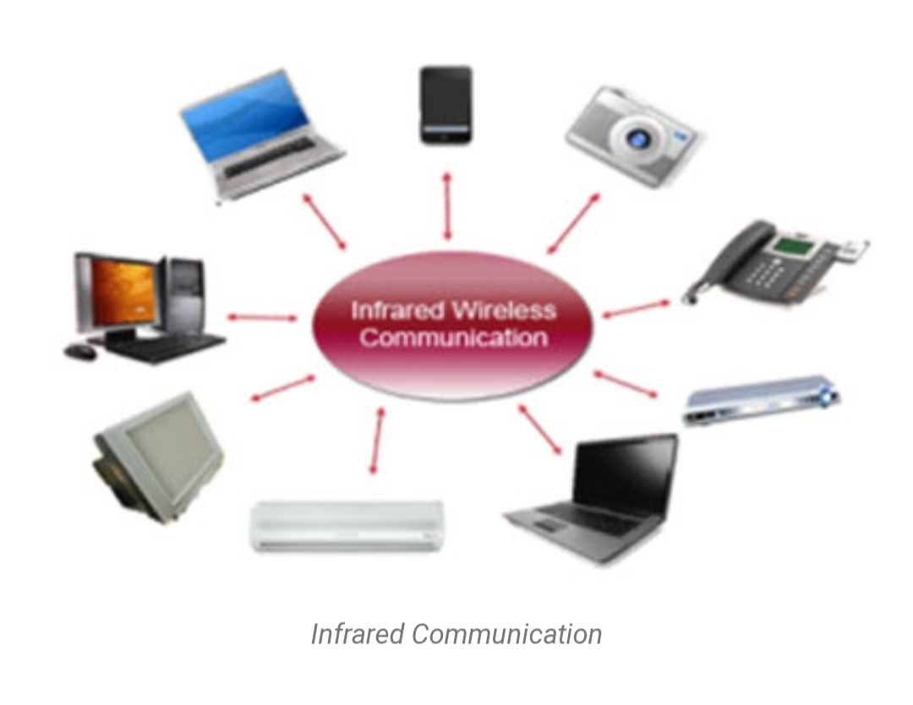
Block Diagram/ Work Flow/ Flow Chart

Slide 5
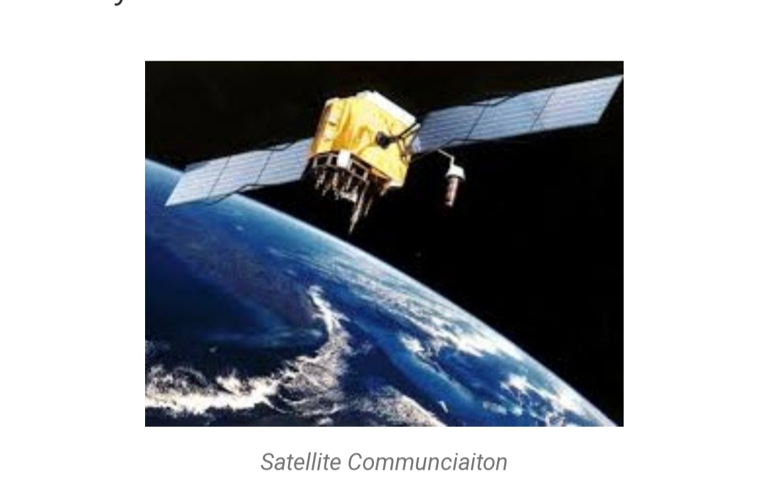
Technical Details

Slide 6
IINFRARED COMMUNICATION.
Infrared wireless communication communicates information in a device or systems through IR radiation .
IR is electromagnetic energy at a wavelength that is longer than that of red light. It is used for security control, TV remote control and short range communications.
In the electromagnetic spectrum, IR radiation lies between microwaves and visible light. So, they can be used as a source of communication

Slide 7
MOBILE COMMUNICATION SYSTEM
The advancement of mobile networks is enumerated by generations. Many users communicate across a single frequency band through mobile phones.
Cellular and cordless phones are two examples of devices which make use of wireless signals.
Typically, cell phones have a larger range of networks to provide a coverage.But, Cordless phones have a limited range

Slide 8
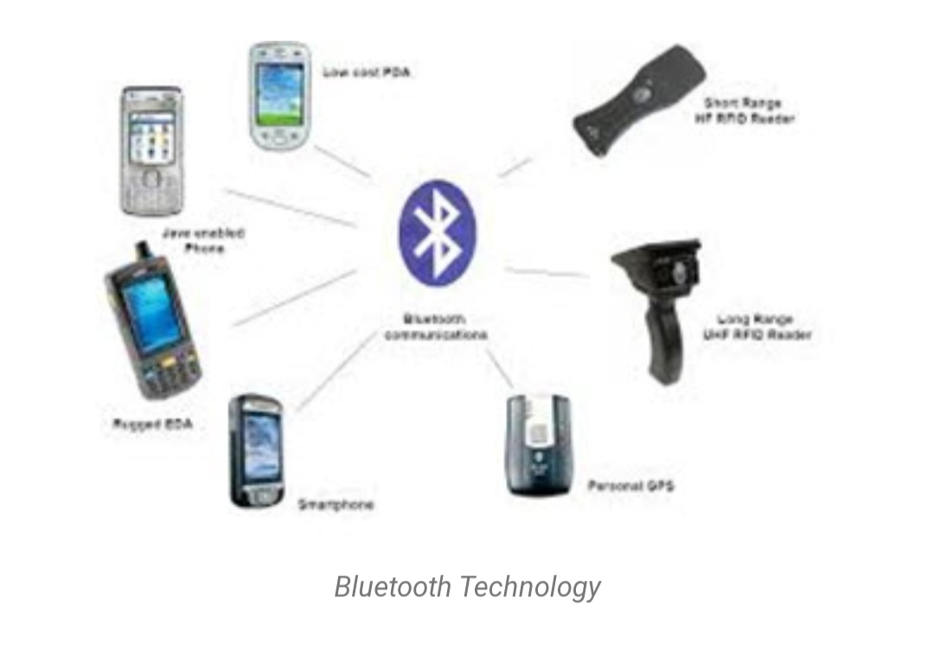
Technical Details

Slide 9
DISADVANTAGES
An unauthorized person can easily capture the wireless signals which spread through the air.
It is very important to secure the wireless network so that the information cannot be misused by unauthorized users

Slide 10
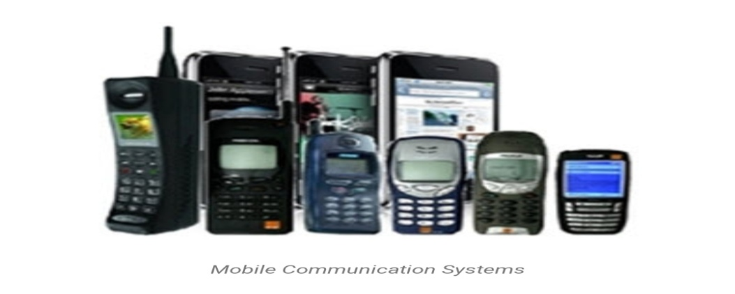
Result & Discussion
Similar to GPS devices, some phones make use of signals from satellites to communicate.

Slide 11
Future Scope
Any data or information can be transmitted faster and with a high speed
Maintenance and installation is less cost for these networks.
The internet can be accessed from anywhere wirelessly
It is very helpful for workers, doctors working in remote areas as they can be in touch with medical centers.

Slide 12
Reference
Wikipedia
LinkedIN
Tutorial Point

